Slide 1

Assistance for Renters & other DHCA Initiatives
Briefing before the Silver Spring Citizens Advisory Board
May 10, 2021
Aseem K. Nigam, Director

Slide 2
COVID-19 Impacts on Housing & Protections for Tenants
Impacts of COVID:
We believe as many as 10-15% of renter households each month are experiencing rent delinquency. As many as 15,000 – 20,000 renter households are behind on rent.
Anyone behind on rent is subject to eviction.
Most homeowners qualify for forbearance on loan payments, for 12-18 months
Eviction Protections for Tenants with COVID related income loss :
Federal CDC Order: Tenants sign a Declaration Form stating COVID income loss and deliver to landlord; attend Court hearing to Suspends eviction to June 30th. Federal judge has vacated the CDC Order; DOG has filed an appeal.
Governor’s Order – Tenants must bring proof of COVID-related impact when they attend their Court hearing, judge can suspend eviction for duration of state of emergency.

Slide 3
Montgomery County Eviction-Prevention Support
Non-profit organizations and DHCA help tenants understand options and prepare for Court
Including one-on-one counseling and support applying for rental assistance
CASA
Housing Initiative Partnership
Latino Economic Development Center
Renters Alliance
Free legal assistance to prepare and at the Courthouse:
Maryland Legal Aid coordinating legal support for tenants at the courthouse.
Tenants with court dates should contact MDLA and prepare to attend court

Slide 4
Broad Outreach to At-Risk Tenants
Flyers hand delivering to buildings in high-risk communities;
Flyers distributed at food sites
Ride-On bus advertisement directing tenants to resources
Tenant nonprofit webinars, trainings, email/text/WhatsApp support
Landlord webinars and emails to connect tenants with resources
Emails to tenants who have applied for assistance
Press Release and County Executive address of support
MCPS and Montgomery College distributions of support availability
Montgomery County al Dia and Council Spanish Language radio

Slide 5
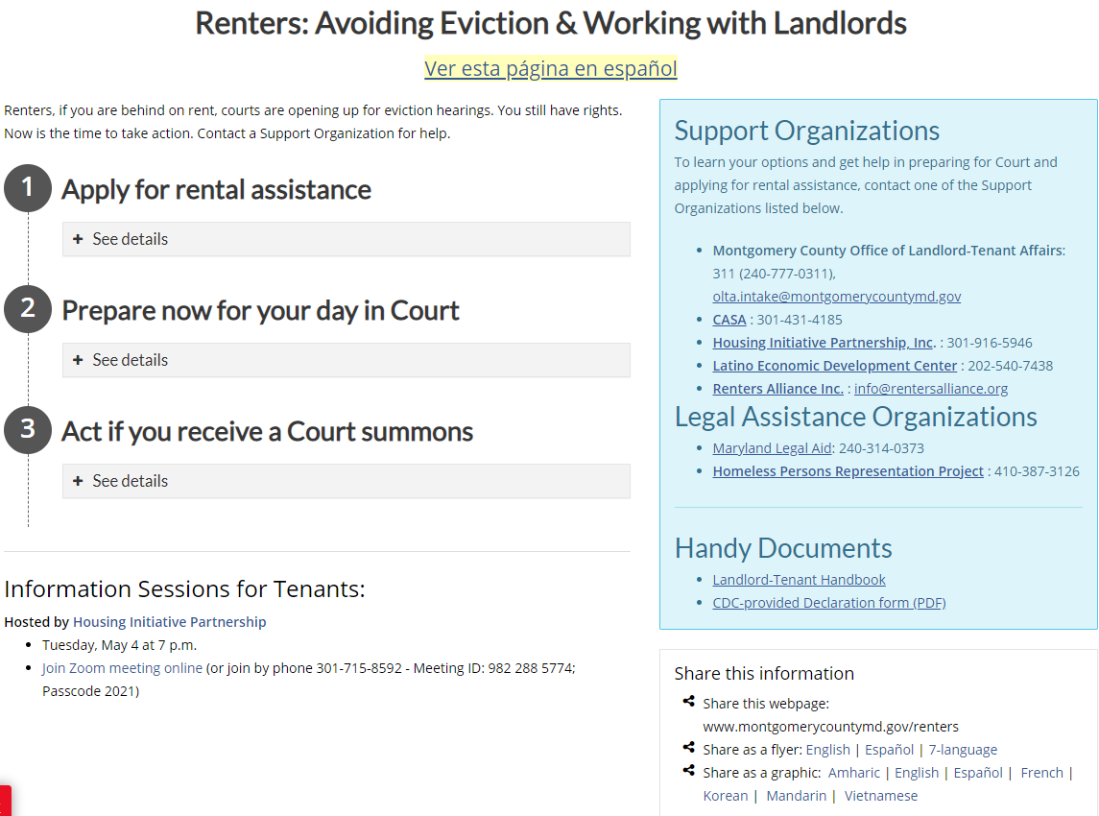
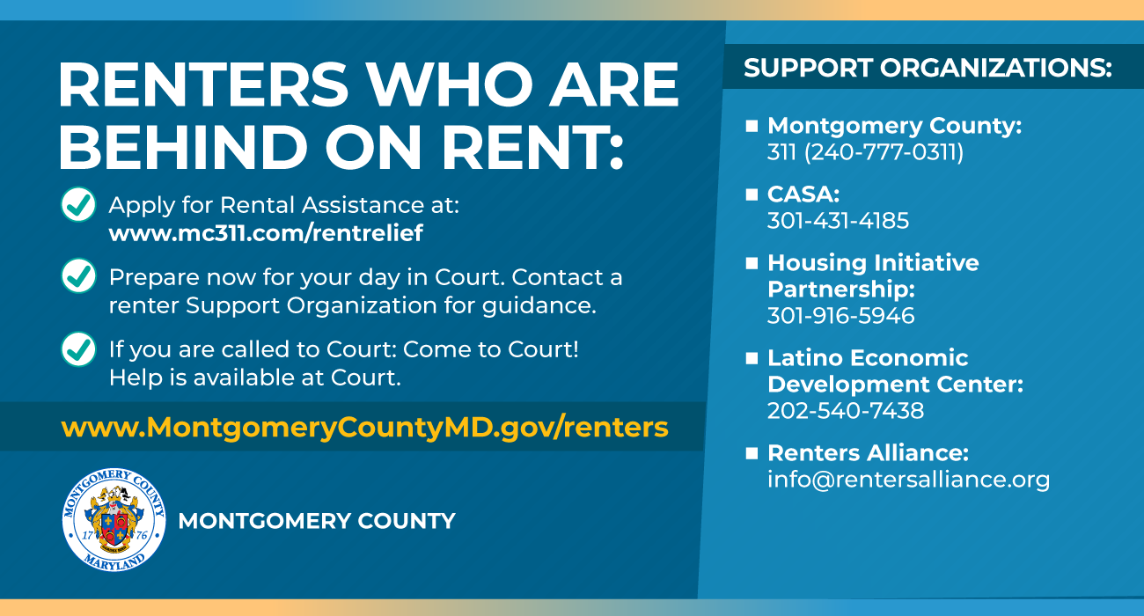
Reaching Renters: e-Outreach and Website
www.montgomerycountymd.gov/renters
Social media & e-newsletters
(available in 7 languages, at /renters)

Slide 6
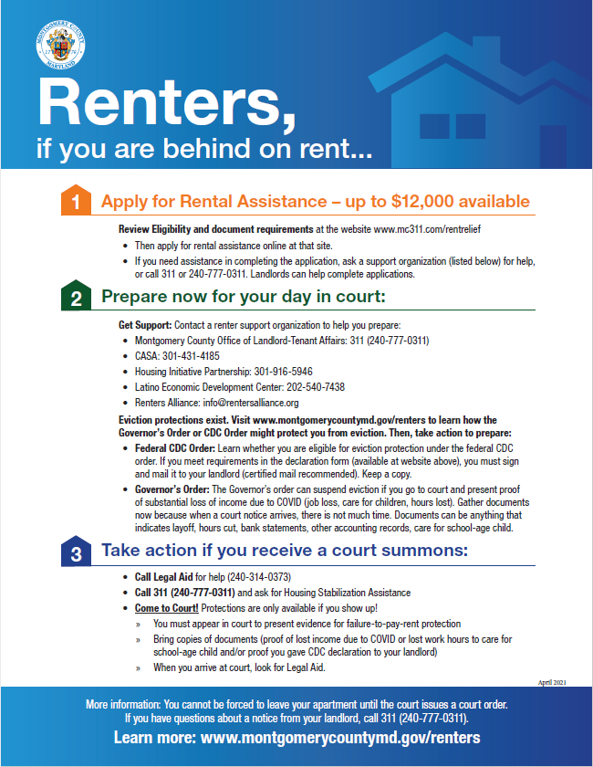
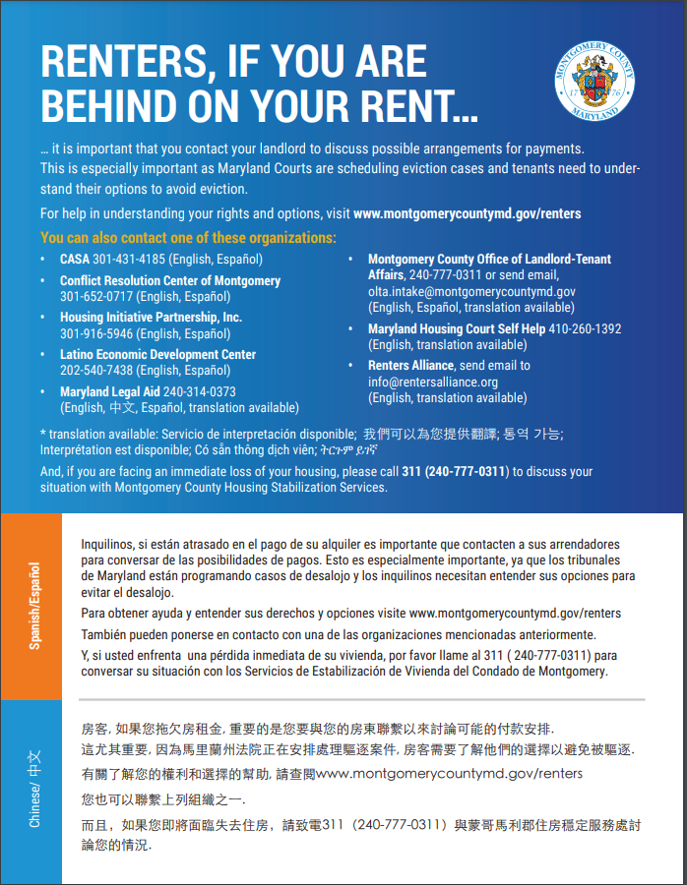
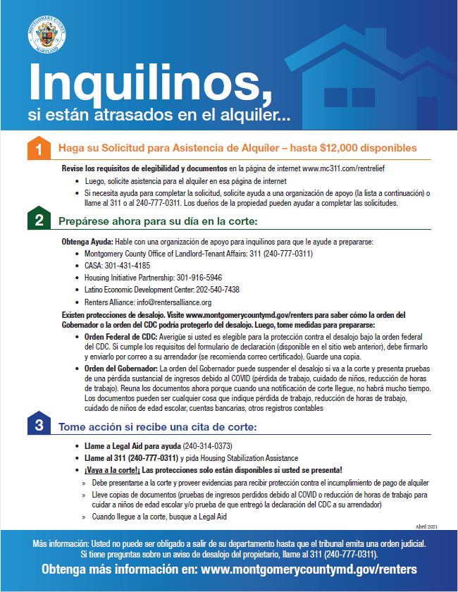
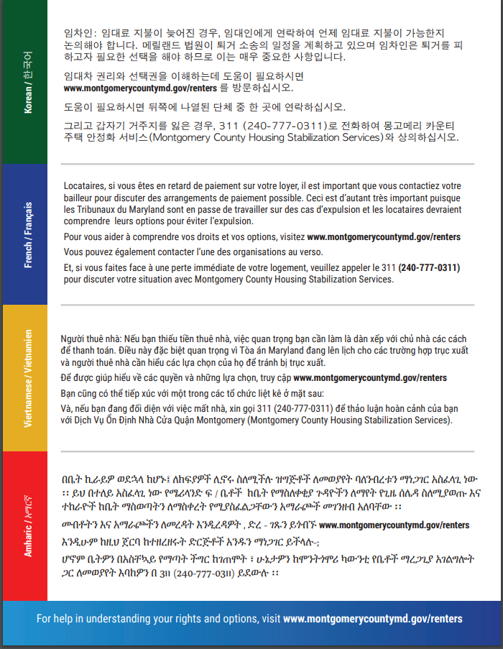
Reaching Renters - Community Outreach
English/Spanish flyer:
7-language flyer:

Slide 7
Increasing Our Investment In Affordable Housing
County Executive Marc Elrich’s Recommendation - Expanded Investment
Recommended FY22 Budget housing funding of $89.1 million, an increase of $14 million from Approved FY21 Budget.
Recommends increasing lending for Preservation and Production by $12 million
Recommends $6 million for creation of new Affordable Housing Opportunity Fund to leverage private capital for acquisition and preservation of affordable housing.

Slide 8
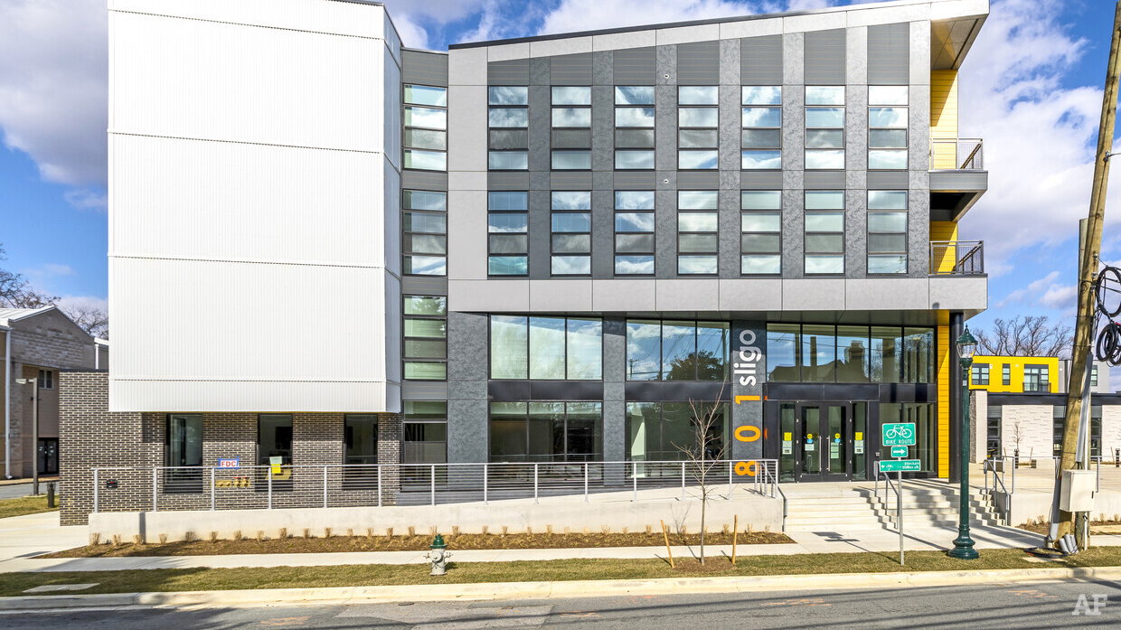
Expanding Affordable Housing in Silver Spring
Artspace, 801 Sligo Avenue:
68 affordable live/work units
(11 are for veterans)
11 townhouses (4 to be Workforce)
Hillbrook Towers, 515 Thayer Avenue:
Preserved 55 units in apartment building, with renovation
Elizabeth Square, 1400 Fenwick Lane:
Recreation/Aquatic Center
Affordable Senior Apartments
Artspace, 801 Sligo Avenue

Slide 9
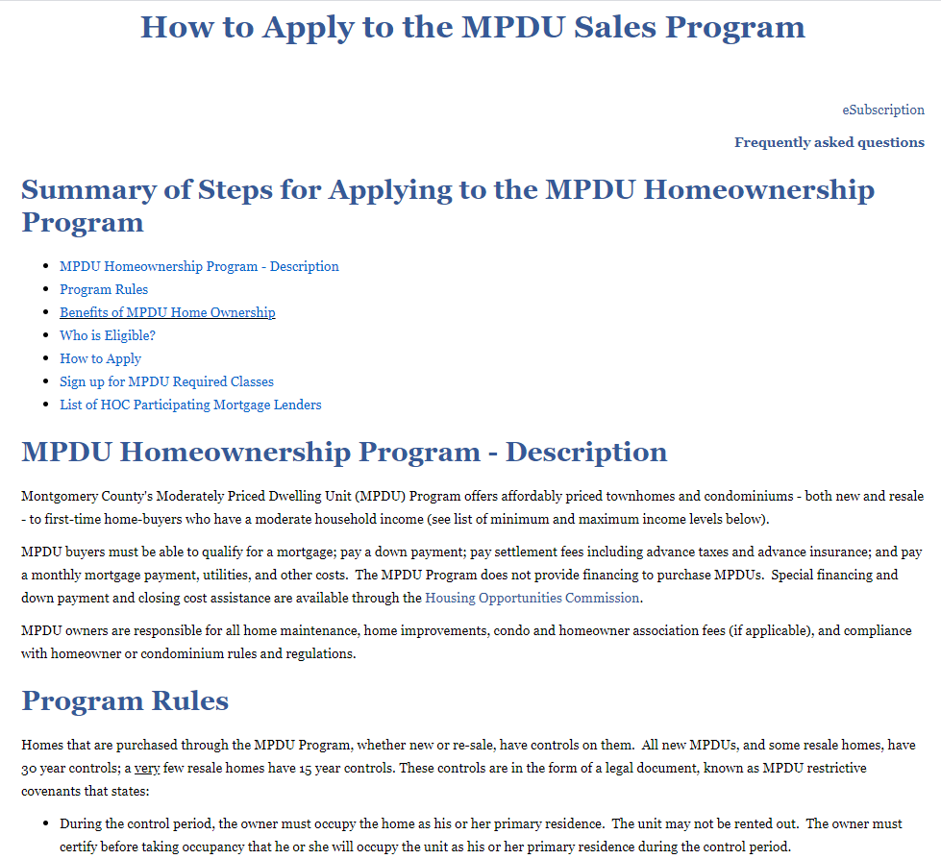
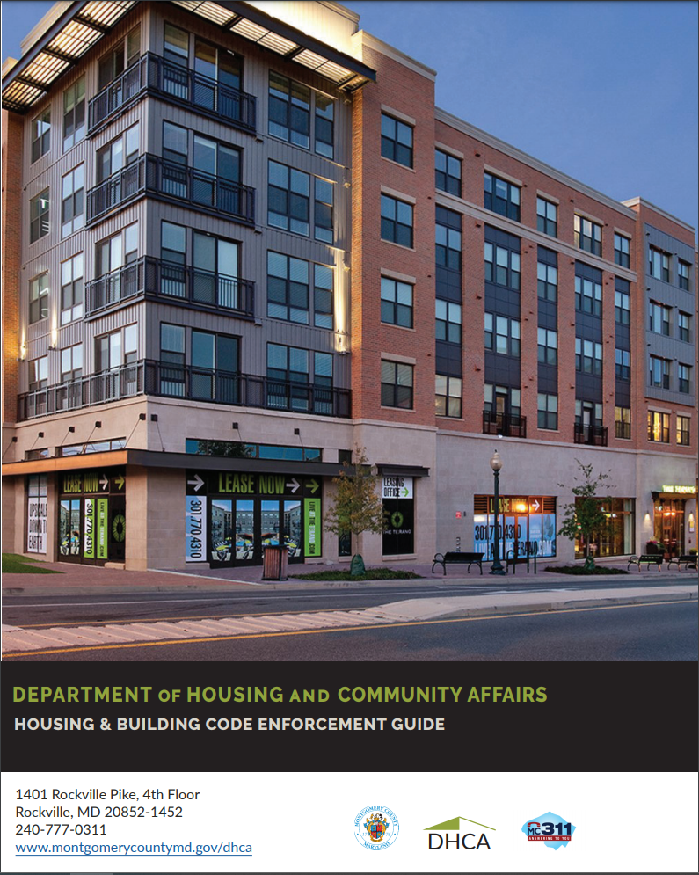
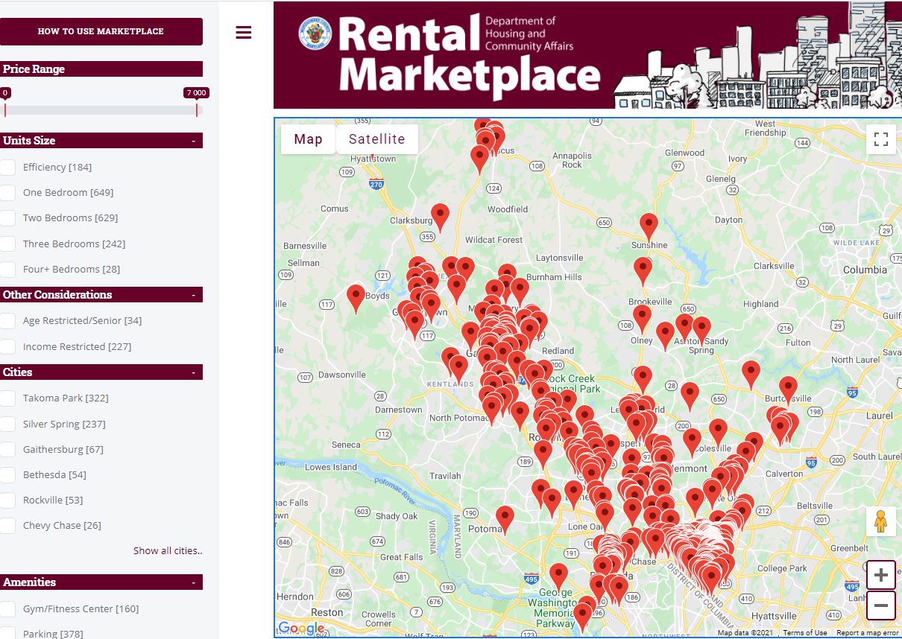
Tech Investments to connect people to our resources
Rental Marketplace
To provide tenants improved access to Rental Housing inventory by type, location and rent levels
Housing Code Handbook
Online to simplify tenant and landlord use
MPDU Sales Portal
New online application process to expand participation
Available online in multiple languages

